Slide 1
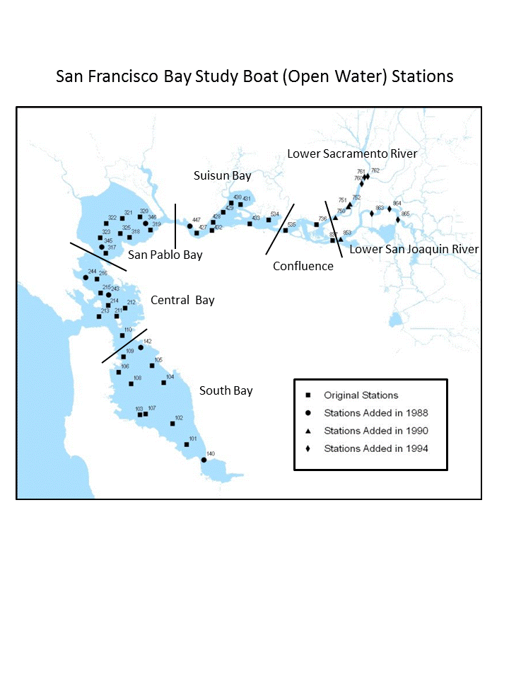

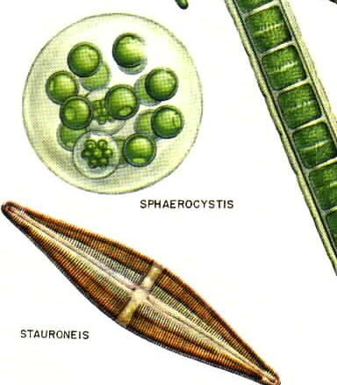
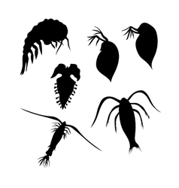
San Pablo Bay
Interagency Ecological Program Status & Trends
2017-2018 Winter Season Report
Delta outflow is a major ecosystem driver and depends on natural hydrological variability and water management operations, including exports from the Delta and reservoir operations.
High Delta outflow causes fresher conditions in San Pablo Bay.
Secchi Depth
Temperature
Organisms in this ecosystem are adapted to high turbidity conditions, and reductions in turbidity can have many negative ecological effects. Higher values for Secchi depth indicate lower turbidity.
Secchi depth is measured monthly by DWR’s Environmental monitoring program by dropping a black-and-white disk in the water until it disappears.
San Pablo bay usually has XXX turbidity compared to the rest of the delta
Here’s some information on Temperature
Temperature in San Pablo bay tends to be lower than the Delta
Chlorophyll
Zooplankton
Chlorophyll is a pigment produced by phytoplankton, and it is used as a measure of primary productivity.
Chlorophyll is measured by processing water samples in a laboratory. Water is sampled monthly by the Environmental Monitoring program.
Chlorophyll in San Pablo Bay tends to be lower than other regions, but is less affected by invasive clams.
Zooplankton are an important source of fish food.
Zooplankton are collected by trawling a net with very fine mesh through the water, then identifying the small invertebrates under a microscope.
Zooplankton in San Pablo bay is dominated by calanoid copepods, which are considered excellent fish food.

Slide 2
Suisun Bay
Interagency Ecological Program Status & Trends
2017-2018 Winter Season Report
Delta outflow is a major ecosystem driver and depends on natural hydrological variability and water management operations, including exports from the Delta and reservoir operations.
High Delta outflow causes fresher conditions in Suisun.
Secchi Depth
Temperature
Organisms in this ecosystem are adapted to high turbidity conditions. Higher values for Secchi depth indicate lower turbidity.
Secchi depth is measured by DWR’s Environmental monitoring program by dropping a black-and-white disk in the water until it disappears.
Suisun Bay has lower turbidity compared to the rest of the delta
Here’s some information on Temperature
Temperature in Suisun bay tends to be lower than the Delta
Chlorophyll
Zooplankton
Chlorophyll is a pigment produced by phytoplankton, and it is used as a measure of primary productivity.
Chlorophyll is measured by processing water samples in a laboratory. Water is sampled monthly by the Environmental Monitoring program.
Chlorophyll in Suisun was hit particularly hard by the clam invasion.
Zooplankton are an important source of fish food.
Zooplankton are collected by trawling a net with very fine mesh through the water, then identifying the small invertebrates under a microscope.
Zooplankton in Suisun bay are now dominated by cyclopoid copepods, which are considered poor fish food.

Slide 3
The Delta
Interagency Ecological Program Status & Trends
2017-2018 Winter Season Report
Delta outflow is a major ecosystem driver and depends on natural hydrological variability and water management operations, including exports from the Delta and reservoir operations.
High Delta outflow causes fresher conditions in Suisun.
Secchi Depth
Temperature
Organisms in this ecosystem are adapted to high turbidity conditions. Higher values for Secchi depth indicate lower turbidity.
Secchi depth is measured by DWR’s Environmental monitoring program by dropping a black-and-white disk in the water until it disappears.
The Delta has higher turbidity compared to the rest of the estuary
Here’s some information on Temperature
Temperature in the Delta bay tends to be higher than the bays
Chlorophyll
Zooplankton
Chlorophyll is a pigment produced by phytoplankton, and it is used as a measure of primary productivity.
Chlorophyll is measured by processing water samples in a laboratory. Water is sampled monthly by the Environmental Monitoring program.
Chlorophyll in Suisun was hit particularly hard by the clam invasion.
Zooplankton are an important source of fish food.
Zooplankton are collected by trawling a net with very fine mesh through the water, then identifying the small invertebrates under a microscope.
Zooplankton in the Delta bay have more cladocerans and calanoid copepods than Suisun Bay.

Slide 4
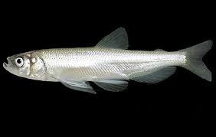
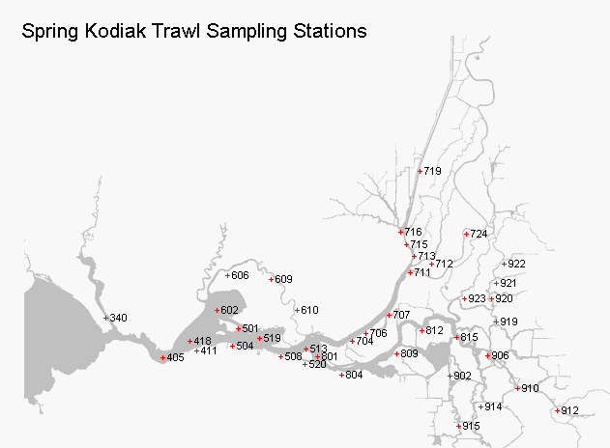
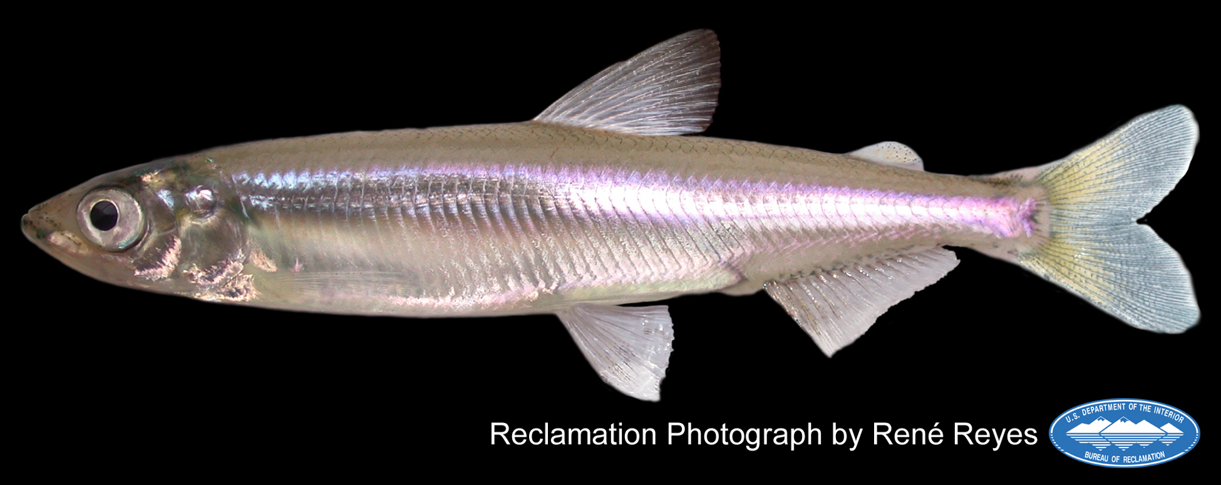
Smelt
Interagency Ecological Program Status & Trends
2017-2018 Winter Season Report
High outflow leads to increased abundance of longfin smelt.
High outflow increases abundance of Delta Smelt only in cooler years.
Longfin Smelt – Bay Study
Longfin smelt experienced sever declines in the early 2000s and have not recovered.
Bay study is the only IEP survey that samples throughout San Francisco Bay, making it especially good at pickup up Longfin Smelt.
It would be cool if the map was actually a bubble plot of their distribution
Delta Smelt - SKT
Spring Kodiak Trawl samples throughout the Bay and Delta.
Delta smelt are not doing so great.

Slide 5
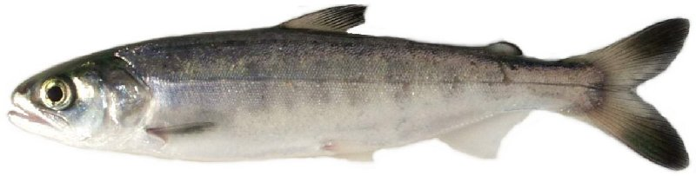
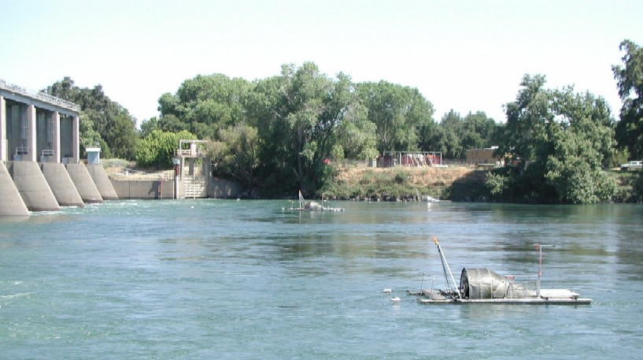
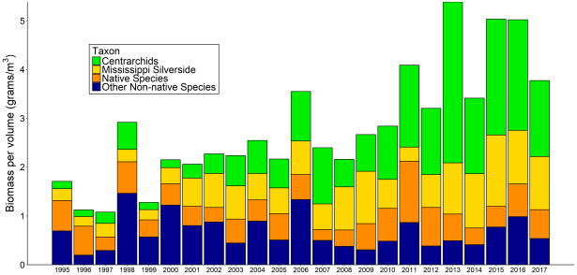
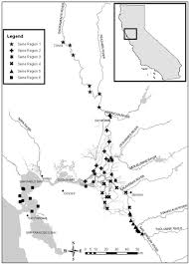
Salmon
Interagency Ecological Program Status & Trends
2017-2018 Winter Season Report
Salmon have been doing OK in recent years, though not amazing.
The drought was hard on them.
Red Bluff Diversion Dam
Preliminary estimates of passage by brood-year (BY) and run for unmarked juvenile Chinook salmon and steelhead trout captured by rotary-screw traps at Red Bluff Diversion Dam (RK391), Sacramento River, CA.
This sampling provides an estimate of production in the upper watershed.
DJFMP beach Seines
DJFMP’s beach seine data provides information on landscape patterns of juvenile chinook occurrence.
Researchers use these patterns to determine differences in salmon life-history.

Slide 6
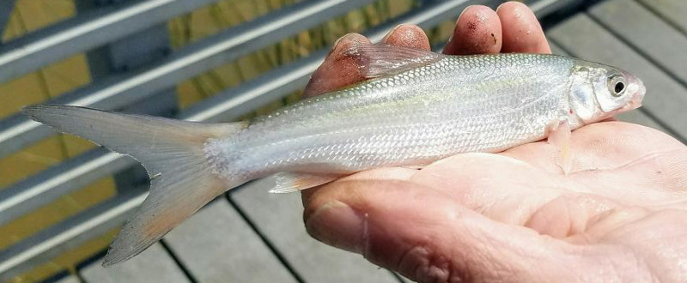
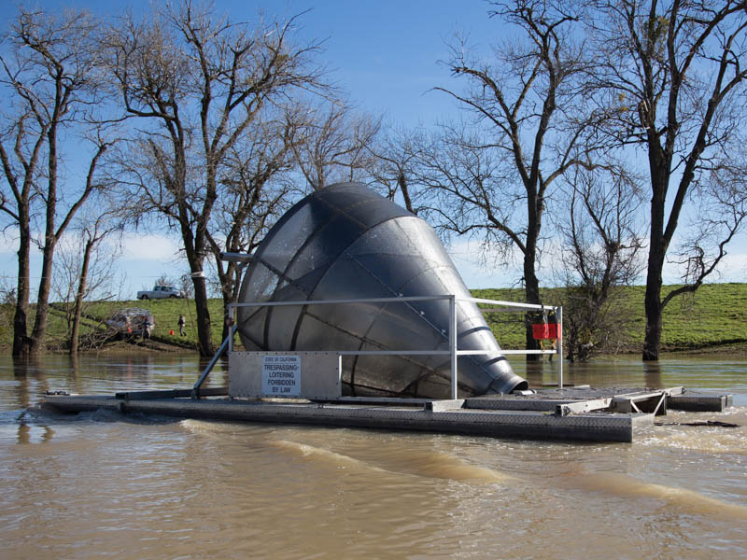
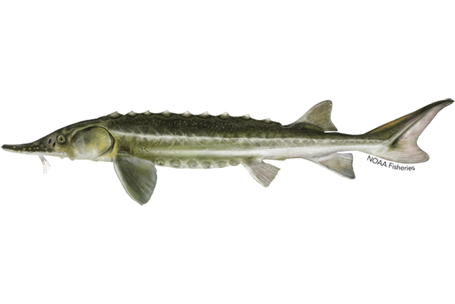
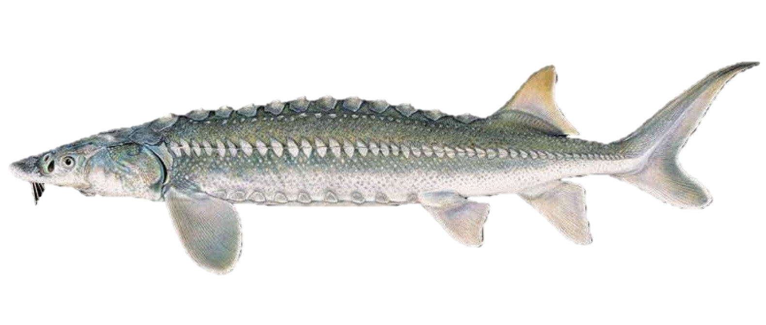
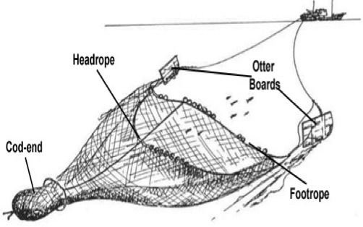
Other fish
Interagency Ecological Program Status & Trends
2017-2018 Winter Season Report
Splittail – Yolo bypass screw trap
Splittail spawn on flood plains such as the yolo bypass
They do really well in wet years.
The screw trap catches a lot of juvenile splittail in the spring after a wet year.
Sturgeon – Bay Study
Juvenile sturgeon are caught in Bay Study’s otter trawl
White sturgeon support a recreational fishery
Green sturgeon are listed as threatened.

